Slide 1
Computational Physics (Lecture 22)
PHY4061

Slide 2
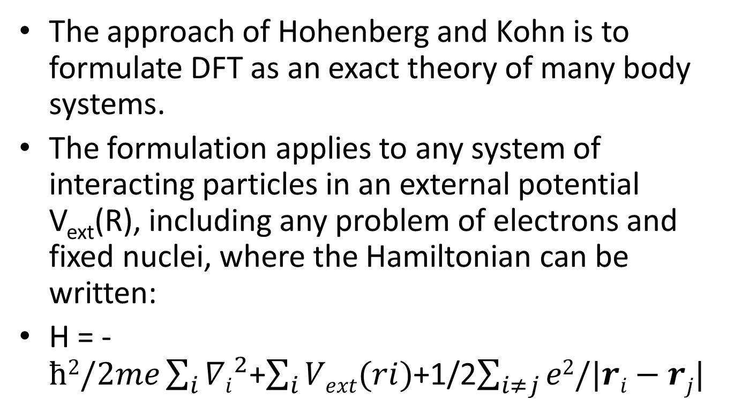
The Hohenberg-Kohn Theorems
The approach of Hohenberg and Kohn is to formulate DFT as an exact theory of many body systems.
The formulation applies to any system of interacting particles in an external potential V_{ext}(R), including any problem of electrons and fixed nuclei, where the Hamiltonian can be written:
H = -$ħ2/2me\sum_{i}{{∇i}_{}^{2}}$+$\sum_{i}{Vext(ri)}$+1/2$\sum_{i≠j}{e2/|ri−rj|}$

Slide 3
Density functional theory is based upon two theorems first proved by Hohenberg and Kohn.
Theorem I: For any system of interacting particles in an external potential V_{ext}(r), the potential V_{ext}(r) is determined uniquely, except for the constant, by the ground state particle density n₀(r).

Slide 4
Corollary I: Since the Hamiltonian is thus fully determined, except for a constant shift of the energy, it follows that the many-body wave-functions for all states (ground and excited) are determined. Therefore all properties of the system are completely determined given only the ground state density n₀(r).

Slide 5
Theorem II : A universal functional for the energy E[n] in terms of the density n(r) can be defined, valid for any external potential V_{ext}(r). For any particular V_{ext}(r), the exact ground state energy of the system is the global minimum value of this functional, and the density n(r) that minimizes the functional is the exact ground state density n₀(r).

Slide 6
Corollary II: The functional E[n] alone is sufficient to determine the exact ground state energy and density. In general, excited states of the electrons must be determined by other means. Mermin showed that thermal equilibrium properties, such as specific heat, are determined directly by the free-energy functional of the density.

Slide 7
Proof of Theorem I: density as a basic variable
Very simple
Consider first theorem I, using the general expressions for the density and energy in terms of the many body wave function. Suppose that there were two different external potentials, V(1) and V(2) which differ by more than a constant and which lead to the same ground state density n(r).
The two external potentials lead to two different hamiltonians, H(1) and H(2), which have two different wave functions Ψ(1) and Ψ(2), which have the same ground state density n₀(r).

Slide 8
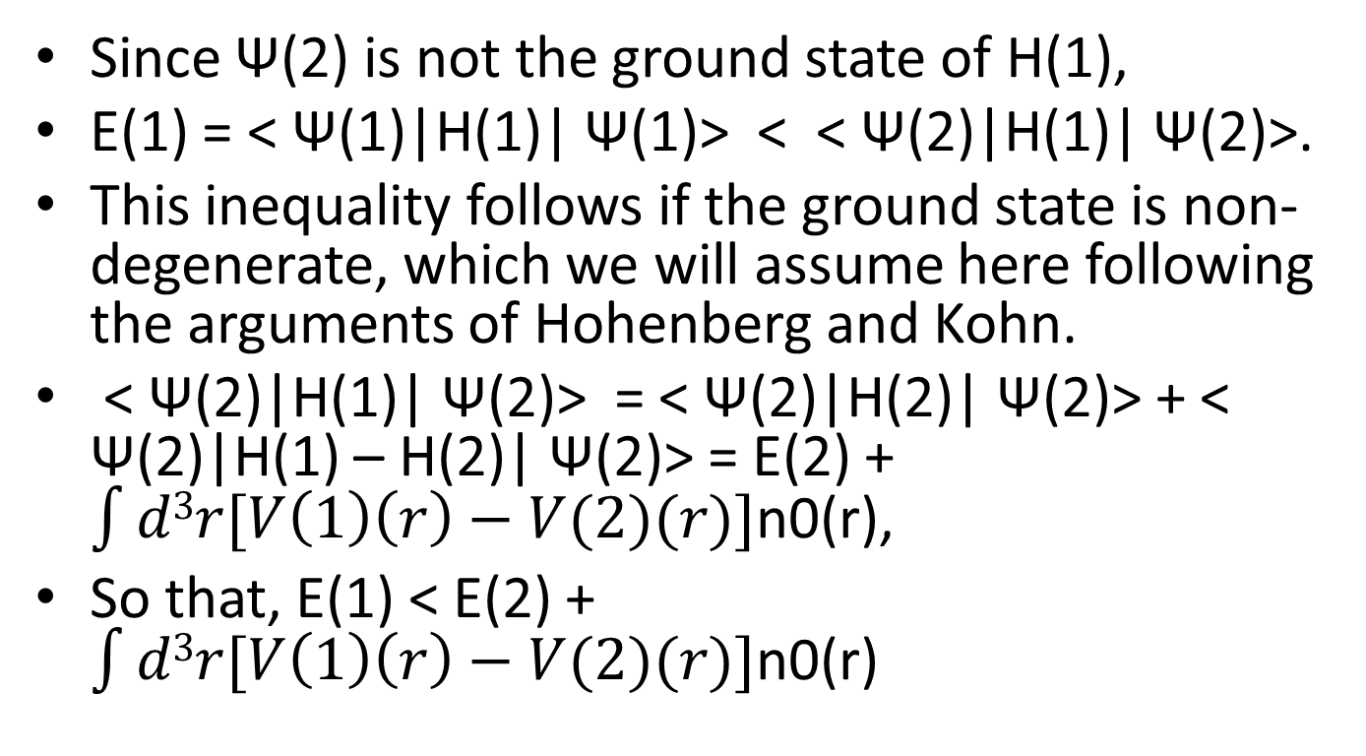
Since Ψ(2) is not the ground state of H(1),
E(1) = < Ψ(1)|H(1)| Ψ(1)> < < Ψ(2)|H(1)| Ψ(2)>.
This inequality follows if the ground state is non-degenerate, which we will assume here following the arguments of Hohenberg and Kohn.
< Ψ(2)|H(1)| Ψ(2)> = < Ψ(2)|H(2)| Ψ(2)> + < Ψ(2)|H(1) – H(2)| Ψ(2)> = E(2) + $\int{d3r[V\left(1\right)\left(r\right)−V(2)(r)]}$n0(r),
So that, E(1) < E(2) + $\int{d3r[V\left(1\right)\left(r\right)−V(2)(r)]}$n0(r)

Slide 9
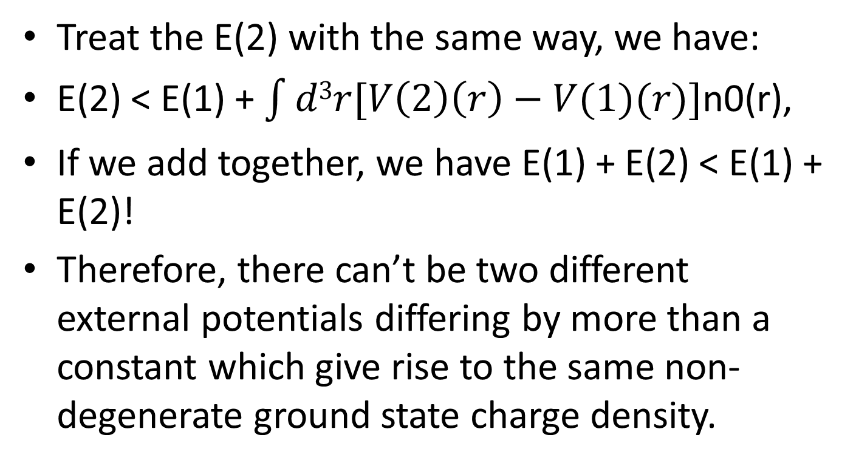
Treat the E(2) with the same way, we have:
E(2) < E(1) + $\int{d3r[V\left(2\right)\left(r\right)−V(1)(r)]}$n0(r),
If we add together, we have E(1) + E(2) < E(1) + E(2)!
Therefore, there can’t be two different external potentials differing by more than a constant which give rise to the same non-degenerate ground state charge density.

Slide 10
The corollary follows since the hamiltonian is uniquely determined by the ground state density.
Then, in principle, the wavefunction of any state is determined by solving the Schrodinger equation with this hamiltonian.
Among all the solutions which are consistent with the given density, the unique ground state wavefunction is the one that has the lowest energy.

Slide 11
Despite the appeal of this result, it is clear from the reasoning that no prescription has been given to solve the problem.
Since all that was proved is that n0(r) uniquely determines Vext(r), we are still left with the problem of solving the many body problem in the presence of Vext(r).

Slide 12
For example, for electrons in materials, the external potential is the Coulomb potential due to the nuclei.
The theorem only requires that the electron density uniquely determines the positions and types of nuclei.
At this level, we have gained nothing!
We are still facing the original problem of many interacting electrons moving in the potential due to the nuclei!

Slide 13
Proof of Theorem II
The second theorem is just as easily proven!
Once one has carefully defined the meaning of a functional of the density and restricted the space of densities.
The original proof of H-K is restricted to densities n(r) that are ground state densities of electron hamiltonian with same external potential Vext.

Slide 14
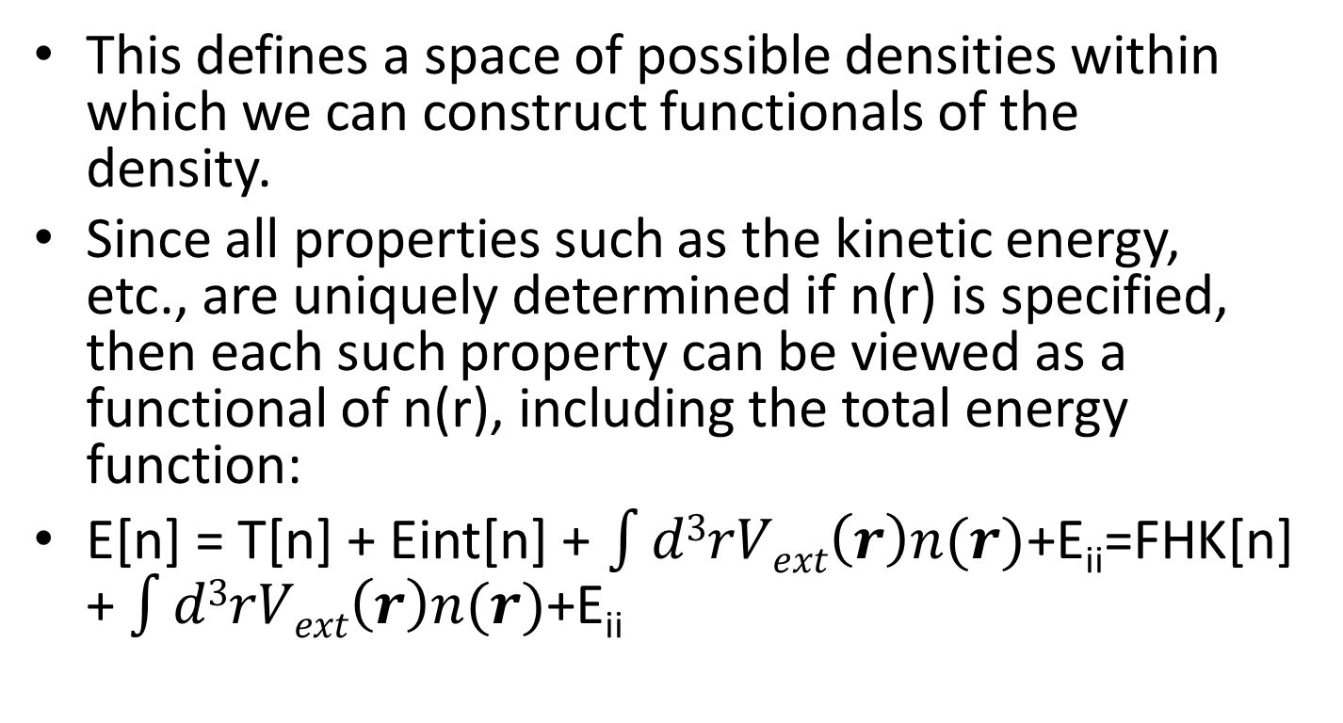
This defines a space of possible densities within which we can construct functionals of the density.
Since all properties such as the kinetic energy, etc., are uniquely determined if n(r) is specified, then each such property can be viewed as a functional of n(r), including the total energy function:
E[n] = T[n] + Eint[n] + $\int{d3rVext\left(r\right)n(r)}$+E_{ii}=FHK[n] + $\int{d3rVext\left(r\right)n(r)}$+E_{ii}

Slide 15
E_{ii} is the interaction energy of the nuclei. The functional FHK[n] includes all internal energies, which must be universal by construction since the kinetic energy and interaction energy of the particles are functionals only of the density.
Now consider a system with the ground state density n(1) (r) corresponding to external potential Vext(r).
Following the discussion above, the HK functional is equal to the expectation value of the hamiltonian in the unique ground state, which has the wave function Ψ(1), E(1) = EHK[n(1)] = < Ψ(1)|H(1)| Ψ(1)>

Slide 16
Now consider a different density, n2(r), which corresponds to a different wavefunction Ψ(2). It follows immediately that the energy E(2) of this state is greater E(1), since
E(1) = < Ψ(1)|H(1)| Ψ(1)> < <Ψ(2)|H(1)| Ψ(2)> = E(2).
Thus the energy in terms of the HK functional evaluated for the correct ground state density n0 is indeed lower than the value of this expression for any other density n(r).

Slide 17
It follows that if the functional FHK[n] was known, then minimizing the total energy of the system, with respect to variations in the density function n(r), one would find the exact ground state density and energy.
This establishes Corollary II.
The functional only determines the ground state properties; it doesn’t provide any guidance concerning excited states.

Slide 18
Constrained search formulation of density functional theory
An alternative definition of a functional due to Levy and Lieb is very instructive
Extends the range of definition of the functional in a way that is formally more tractable and clarifies its physical meaning;
Provides an in-principle way to determine the exact functional;
Leads to the same ground state density and energy at the minimum as in the Hohenberg-Kohn analysis, and also applies for degenerate ground states.

Slide 19
The idea of Levy and Lieb (LL) is to define a two step minimization procedure beginning with the usual general expression for the energy in terms of the many-body wave function Ψ.
The ground state can be found by minimizing the energy with respect to all the variables in Ψ.

Slide 20
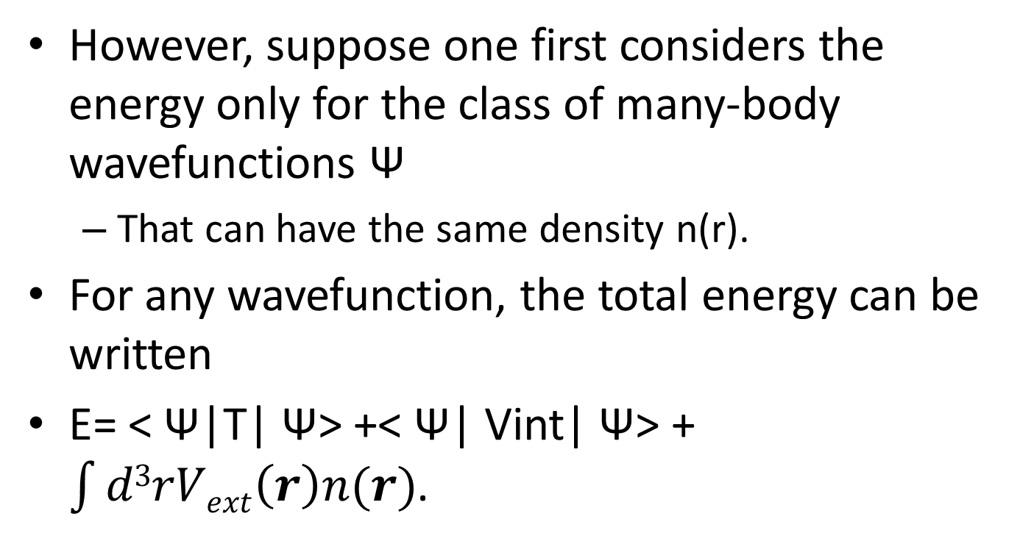
However, suppose one first considers the energy only for the class of many-body wavefunctions Ψ
That can have the same density n(r).
For any wavefunction, the total energy can be written
E= < Ψ|T| Ψ> +< Ψ| Vint| Ψ> + $\int{d3rVext\left(r\right)n(r)}$.

Slide 21
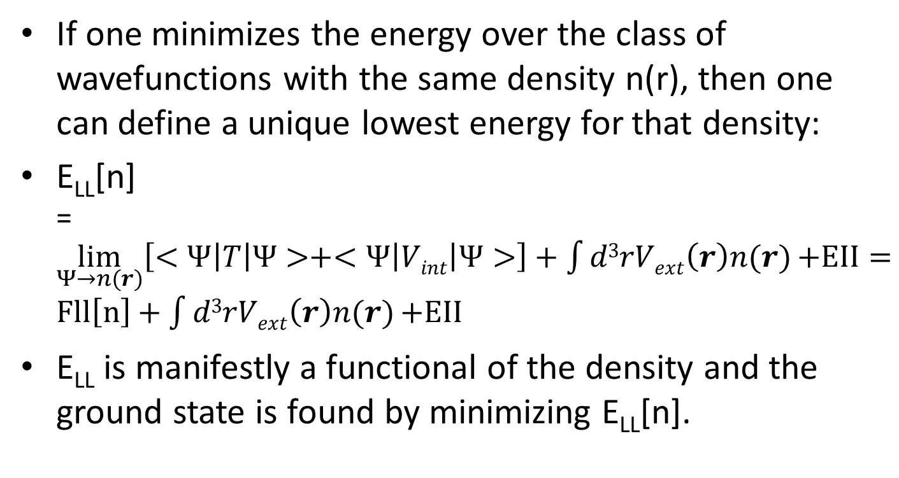
If one minimizes the energy over the class of wavefunctions with the same density n(r), then one can define a unique lowest energy for that density:
E_{LL}[n] =$\lim_{Ψ→n(r)}\left[<Ψ\left|T\right|Ψ>+<Ψ\left|Vint\right|Ψ>\right]+\int{d3rVext\left(r\right)n(r)}\text{+}\text{EII}=Fll\left[n\right]+\int{d3rVext\left(r\right)n(r)}\text{+}\text{EII}$
E_{LL} is manifestly a functional of the density and the ground state is found by minimizing E_{LL}[n].

Slide 22
It clarifies that: the minimum of the sum of kinetic plus interaction energies for all possible wavefunctions having the given density n(r).
The LL functional is defined for any density n(r) derivable from a wavefunction for N electrons.
N representability vs. V respresentability.
At a minimum of the total energy of the system in a given external potential, LL must equal the HK functional.
LL also removes the restriction in the original proof of HK to non-degenerate ground states.

Slide 23
A functional can be defined for any density, and that by minimizing this functional, one would find the exact density and energy of the true interacting many-body system.
No method has been given to find the functional other than the original definition in terms of many body wave functions.

Slide 24
Extensions of Hohenberg-Kohn theorems
Spin density functional theory
HK theorems can be generalized to several types of particles.
The reason for the special role of the density and the external potential in the HK theorems, rather than some other properties of the particles, is simply that these quantities enter the total energy explicitly only through the integral term of Vext.
If there are other terms in the hamiltonian having this form, then such pair of external potential and particle density will obey a HK theorem.

Slide 25
The most relevant example for our purposes is a Zeeman term that is different for up and down spin fermions.
Magnetic field that acts only on the spins, not on the orbital motions.
One of the important effects of an external magnetic field, so that this can be considered as a physically realistic approximation.

Slide 26
Within this model, one can rigorously generalize all the above arguments to include two types of densities, the particle density n(r) = n(r, up) + n(r, down), and the spin density s(r) = n(r, up) – n(r, down).
This leads to an energy functional:
E = E_{HK} [n,s] = E_{HK}’[n]
In the last form, it is assumed that [n] denotes a functional of the density which depends upon both position in space r and spin.

Slide 27
Spin density functional theory is essential in the theory of atoms and molecules with net spins, as well as solids with magnetic order.
Need extension to include magnetic field upon orbital motion.
In the absence of external Zeeman fields, the lowest energy solution may be spin polarized.
Up spin is not equal to down spin.
The broken symmetry solution of unrestricted Hartree-Fock theory.

Slide 28
The original HK theorem remains valid and the ground state, in principle, is determined by the total ground state density n(r) = n(r, up) +n(r,down) for any system where there is no spin dependent external potential.

Slide 29
Mermin finite temperature and ensemble density functional theory
The theorems of Hohenberg and Kohn for the ground state carry over to the equilibrium thermal distribution by constructing the density corresponding to the thermal ensemble.
For each of the conclusions of Hohenberg and Kohn for the ground state, there exists a corresponding argument for a system in thermal equilibrium, as was shown by Mermin.

Slide 30
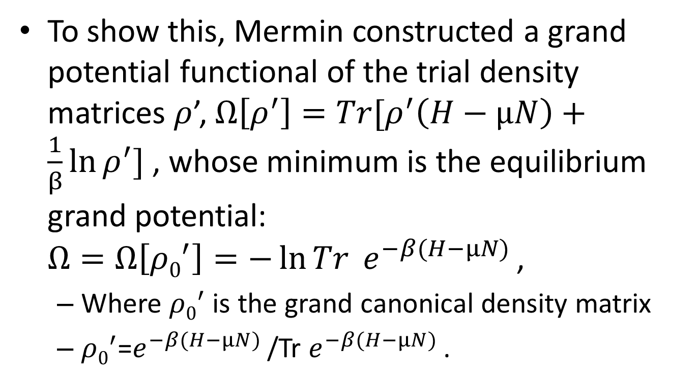
To show this, Mermin constructed a grand potential functional of the trial density matrices $ρ$’, $Ω\left[ρ^{′}\right]=Tr[ρ^{′}\left(H−μN\right)+\frac{1}{β}\ln{ρ^{′}}]$ , whose minimum is the equilibrium grand potential: $Ω=Ω\left[{ρ0}^{′}\right]=−\ln{Tr }e^{−β(H−μN) }$,
Where ${ρ0}^{′}$ is the grand canonical density matrix
${ρ0}^{′}$=$e^{−β(H−μN) }$/Tr $e^{−β(H−μN) }$.

Slide 31
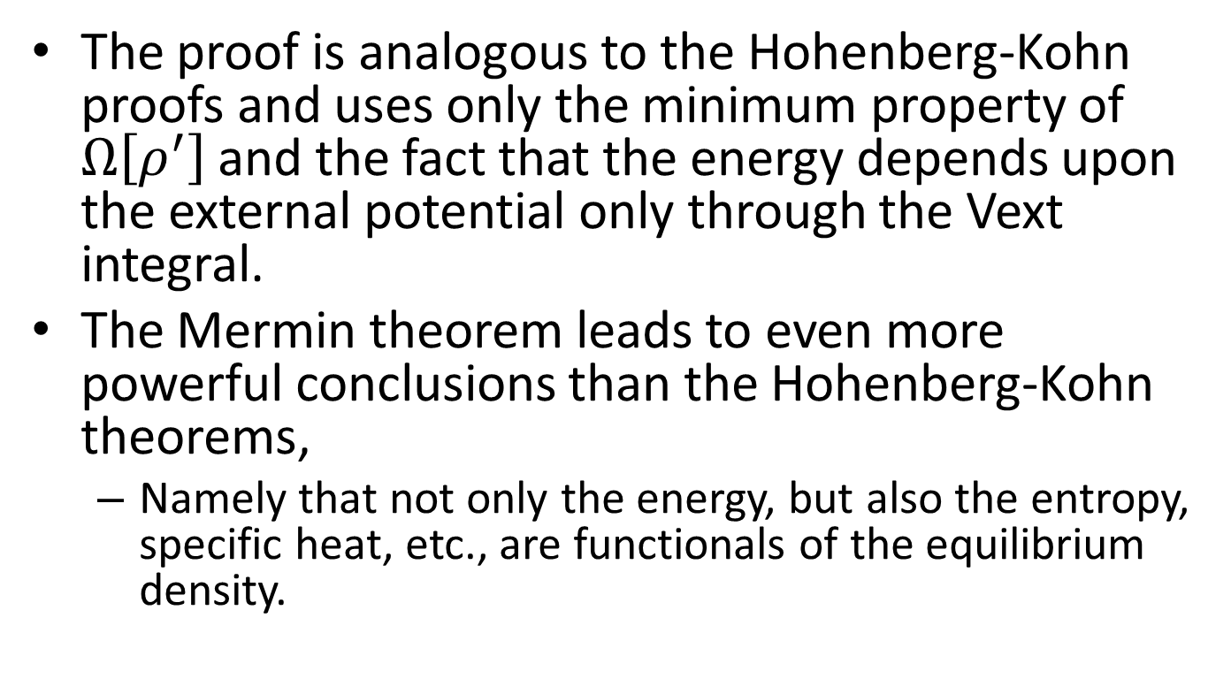
The proof is analogous to the Hohenberg-Kohn proofs and uses only the minimum property of $Ω\left[ρ^{′}\right]$ and the fact that the energy depends upon the external potential only through the Vext integral.
The Mermin theorem leads to even more powerful conclusions than the Hohenberg-Kohn theorems,
Namely that not only the energy, but also the entropy, specific heat, etc., are functionals of the equilibrium density.

Slide 32
However, the Mermin functional has not been widely applied.
The simple fact
it is much more difficult to construct useful, approximate functionals
for the entropy (which involves sums over excited states) than for the ground state energy.
For example, in the Fermi liquid description of a metal the specific heat coefficient at low temperature is directly related to the effective mass at the Fermi surface.
Thus the Mermin functional for the free energy must correctly describe the effective mass (with all its many-body renormalization) as well as the ground state energy.

Slide 33
Current functionals
From the beginning, the HK theorems assumed that the Hamiltonian is time reversal invariant.
If there is a magnetic field, the density is not enough
The properties of the system are a functional of both the density and the current density.
The theory is not as well developed as that for current density.

Slide 34
Time dependent density functional theory
The Hohenberg-Kohn theorem have also been extended to the time domain, where it has been shown that, given the initial wavefunction at one time, the evolution at all later times is a unique functional of the time dependent density.
There has recently been considerable progress along these lines.

Slide 35
It has recently been pointed out that in an extended system,
i.e. one with no boundaries, the evolution is not a functional only of the density.
A simple counter example is a uniform ring of charge that can flow around the ring.
Since the density is always uniform, the state of the system is determined only if an extra condition, the current, is specified.

Slide 36
Electric fields and polarization
The issue of electric fields and polarization comes into play in extended systems.
In finite space, the potential due to an electric field V = Ex is unbounded;
There is no lower bound to the energy and therefore there is no ground state!
This is a famous problem in the theory of the dielectric properties of materials.
However, if the ground state does not exist, the HK theorems on the ground state do not apply.

Slide 37
Is there any way to include an electric field in DFT?
Very subtle problem and the answer is that in the presence of an electric field, one must apply some constraint, within which there is a stable ground state.
In the case of molecules, this is routinely done simply by constraining the electrons to remain near the molecules.
In a solid, the constraint is not so obvious.
All proposals involve constraining the electrons to be in localized Wannier functions or equivalent conditions on Bloch functions.

